Slide 1
DIGITAL PORTFOLIO
STUDENT NAME:N.SANDYA
REGISTER NO: asUnm293222403898
DEPARTMENT: BSC COMPUTER SCIENCE WITH DATA SCIENCE
COLLEGE:VIDHYA SAGAR WOMEN’S COLLEGE

Slide 2
AGENDA
PROBLEM STATEMENT
PROJECT OVERVIEW
END USERS
TOOLS AND TECHNOLOGIES
PORTFOLIO DESIGN AND LAYOUT
FEATURES AND FUNCTIONALITY
RESULT AND SCREENSHOT
CONCLUSION
GITHUB LINK

Slide 3
Problem statement
In today’s digital era, having a Personal online presence is
essential. A static resume is not enough to show case skills and
Achievements .Therefore ,there is a need for a portfolio website
Where certificate, projects, and contact information can be easily
displayed in an attractive manner.

Slide 4
Project overview
This project is a personal portfolio website built using HTML,
CSS, and Java Script. It contains a hero section for introduction, an
about section for personal details , a certificate section where
users can upload and view achievements, and a footer with
contact details The website is responsive and user-friendly.

Slide 5
End users
Recruiters & Interviewers: It is quickly evaluate skills, achievements, and certifications.
Peers & Colleagues: Collaborate and connect professionaaly.
General Audience: Anyone interested in learning more about
your skills and carrer journey.

Slide 6
Tools & technology
HTML5 – For styling, layout, and visual design.
CSS3 – For styling, layout, and visual design.
Java Script – For interactivity and dynamic certificate uploading.
Local Storage – To store and retrive uploaded certificate images.

Slide 7
Features & Functionality
Hero Section – Introduction the user with name, role, and buttons.
About Section – Gives a short description of background and buttons.
Certificate Section – Allow uploading images dynamically using JavaScript.
Interactive Design – Hover effects, animations, and responsive layout.
Footer/Contact Section – Provides email, phone, and LinkedIn for communication.

Slide 8
Result & ScreenShorts
The final portfolio Is an attractive , interactive, and
professional – looking website. It successfully displays
certificates, adapts to different screen sizes, and allows users
to save and revisit uploaded achivements. The UI is clean
modern, and easy to navigate

Slide 9
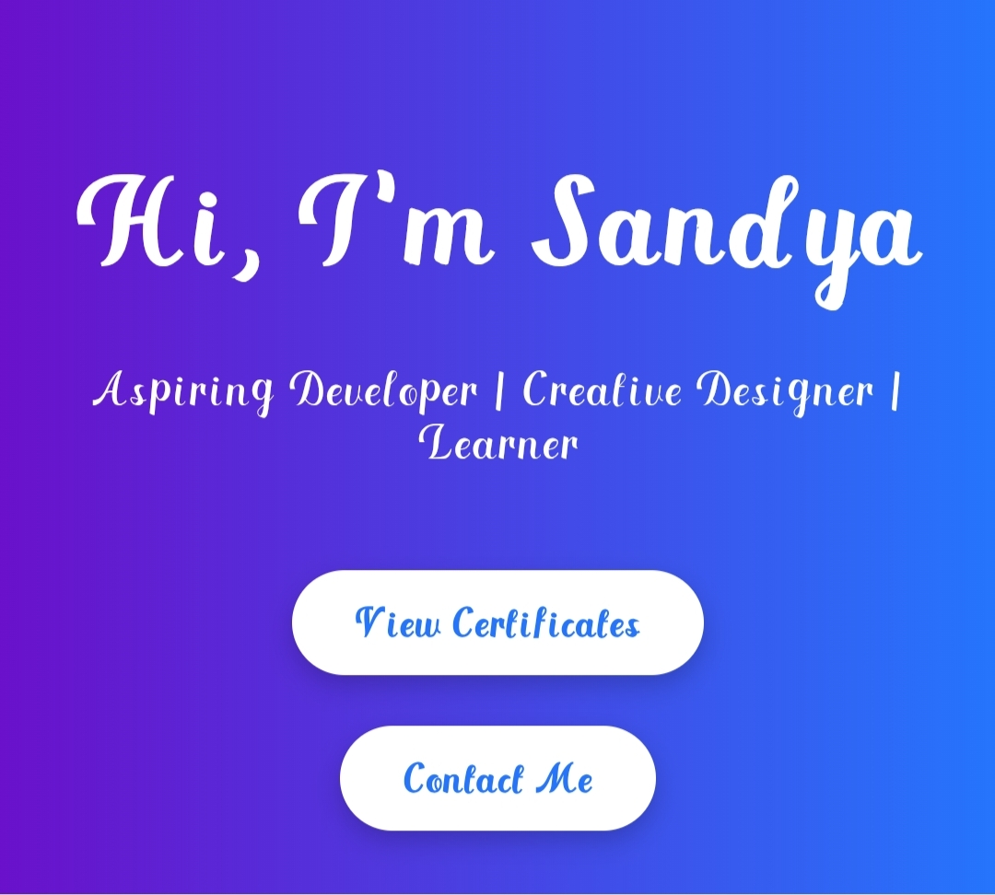
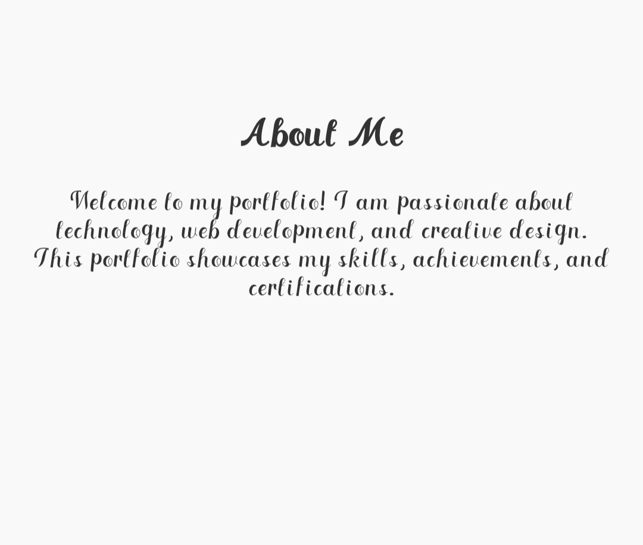
Screenshots

Slide 10
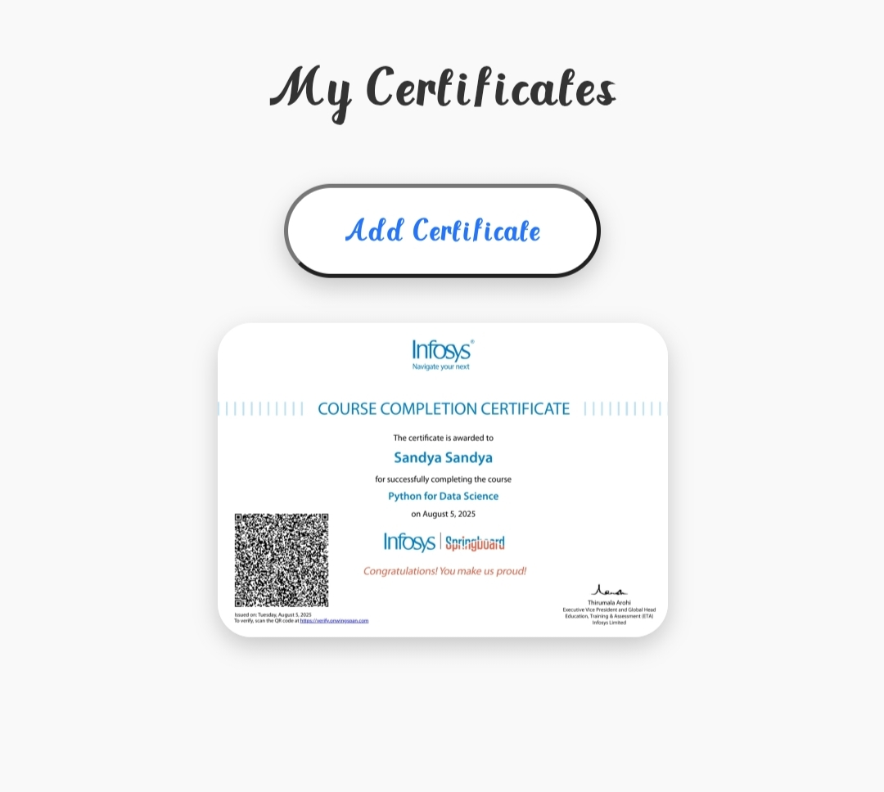
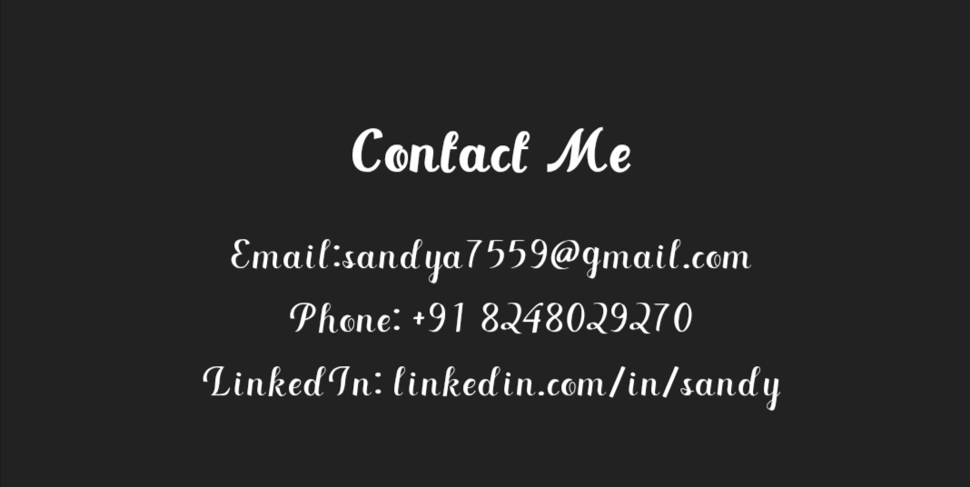
Screenshots

Slide 11
Conclusion
This project demonstrates how web technologies can be used efficiency to
create a professional online portfolio. It not only highlights personal skills and
certifications but also provides an engaging user experience. Overall, it fullfills
the need for a digital presence and can be expanded with were features in the
future.

Slide 12


